Slide 1
Sequel Pro manual
Lecturer: Yong Liu
Contact me at: Yong.liu@aalto.fi

Slide 2
Short introduction
This is a very short introduction of how to use Sequel Pro, given that the software does not provide any official manual.
I would encourage you to explore the software, since most functions available at HeidiSQL also available at Sequel Pro albeit using a different interface. You just need sometime to explore it.

Slide 3
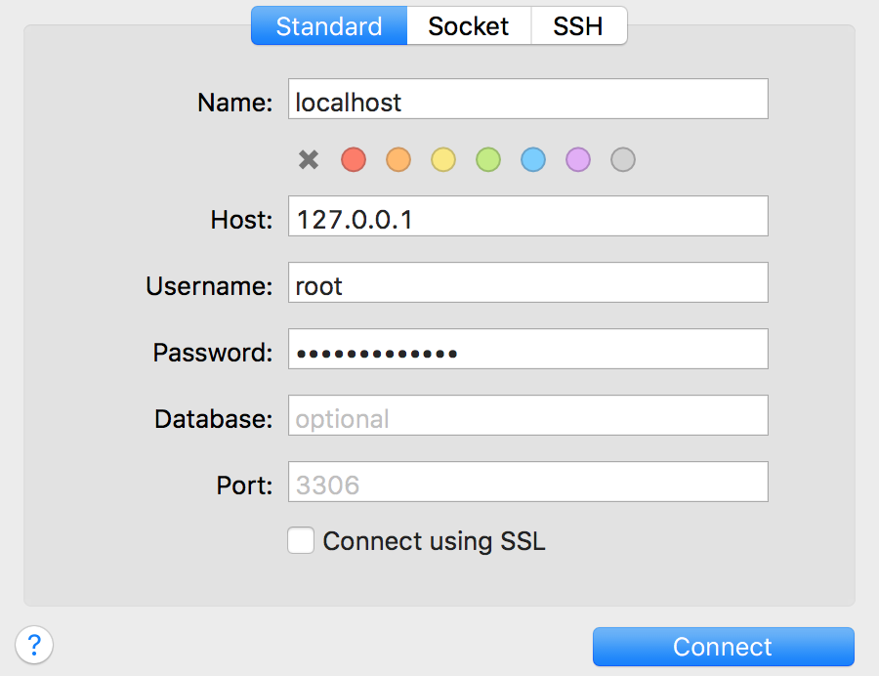
Set up a local account
After open the software, please type: “127.0.0.1” for Host; “root” for Username; “3306” for Port (in default).
You can give a “Name” for your local database, such as “localhost” as shown in the left figure.
Hope you still remember the password you set for MySQL root account, otherwise we have to reset root password for MySQL
Then, click “Connect”

Slide 4
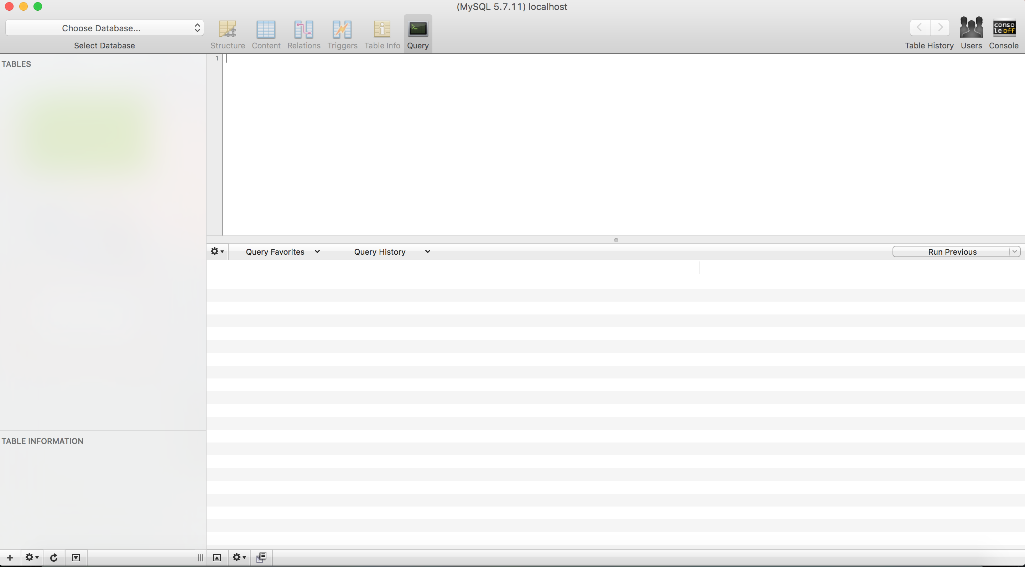
After clicking “Connect”, you will arrive at the following interface.
“Query window”
This is where you type and run MySQL query!
Table or account window
This is where you will see the list of tables in your database
This is where you will see the results from running a MySQL query!

Slide 5
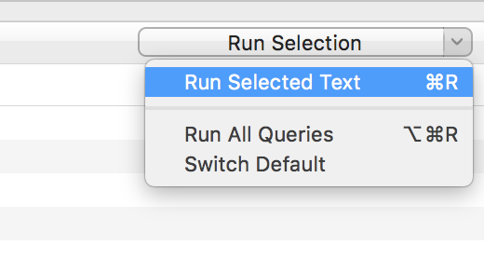
Importing a database to Sequel Pro:
Please download “classicmodels (using your own laptop).sql” file from MyCourse.
Click “File” → “open” to select your database file, then click “Run All Queries” from middle right place of the software.
Note that you can select to run part of your code via clicking on “Run Selected Text”

Slide 6
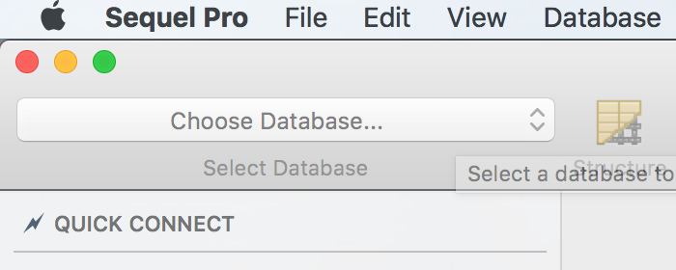
Opening a existing database in Sequel Pro:
After importing or creating a database in Sequel Pro, you can choose the database to use by clicking “choose database” from top left corner of the software.
You could activate the “classicmodels” database from the course for instance. Thereafter, you will be able to the list of tables in the database from the “Table or account window”.

Slide 7
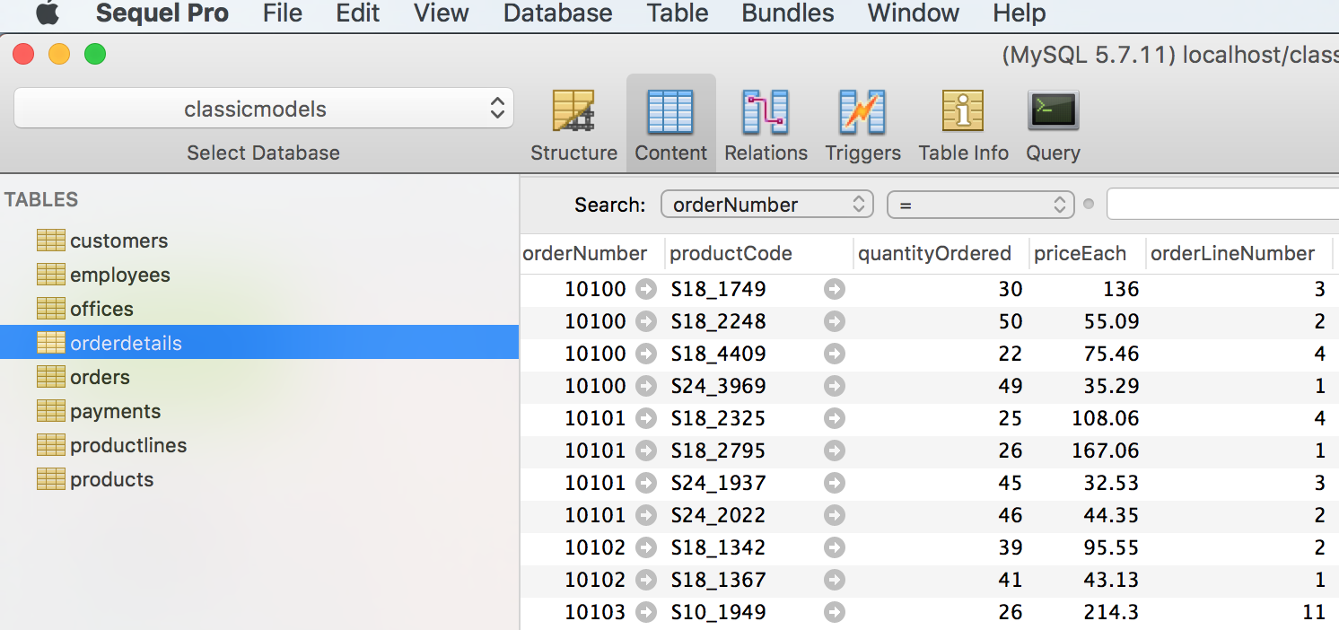
Showing the data
Clicking the table that you want to see the data from.
Click “content” option.

Slide 8
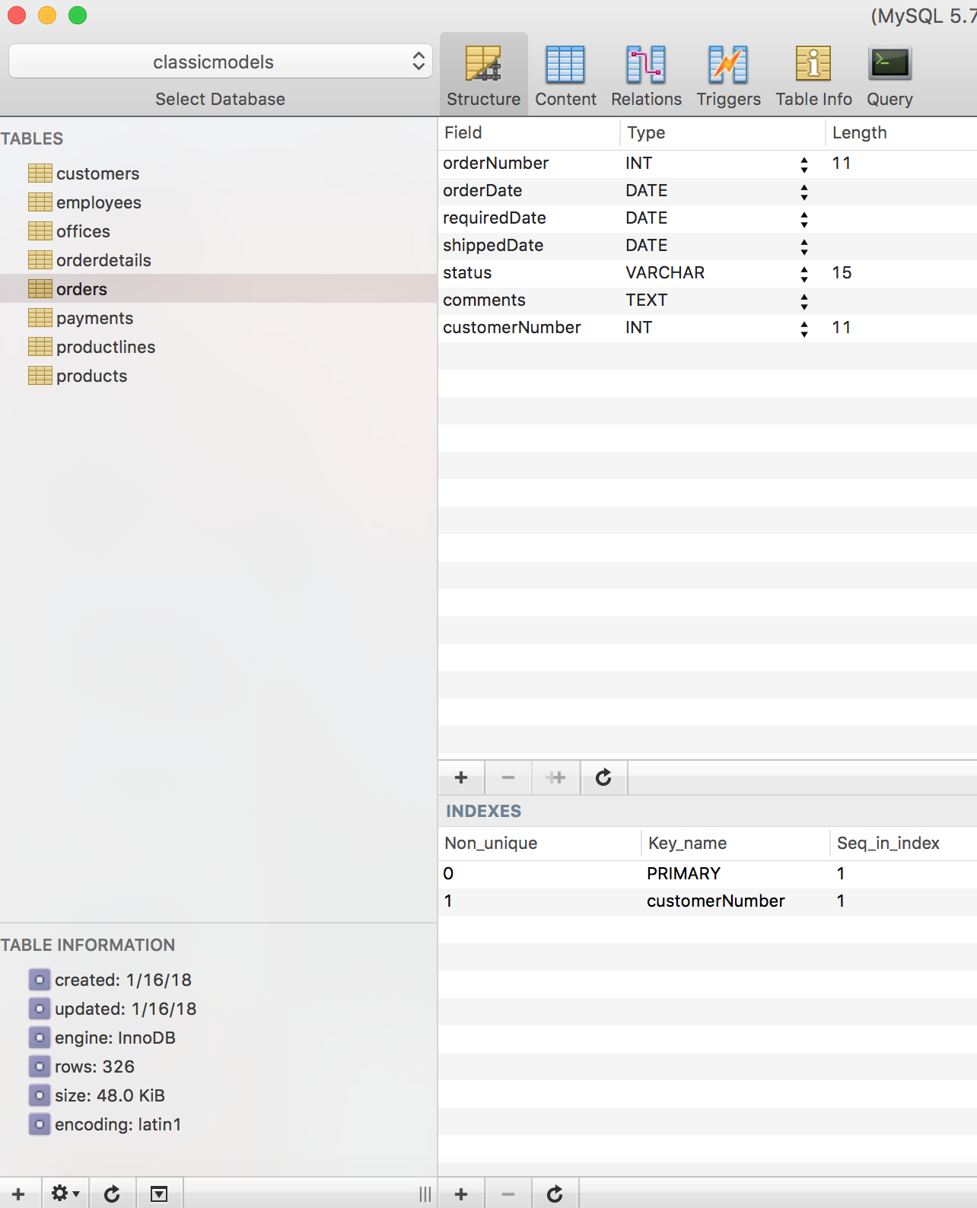
As highlighted in red pane, there are several options:
“structure” shows the structure of a table, such as variable name, variable type, length of a string field.
In the “structure” window, the information of key used in the table is shown at the bottom.

Slide 9
In the ”structure” window, you can
Add or delete a variable from the table;
Add or delete a key from the table

Slide 10
In the ”structure” window, you can
Delete, duplicate or rename after right clicking on a table.
Add a new table to the database.

Slide 11
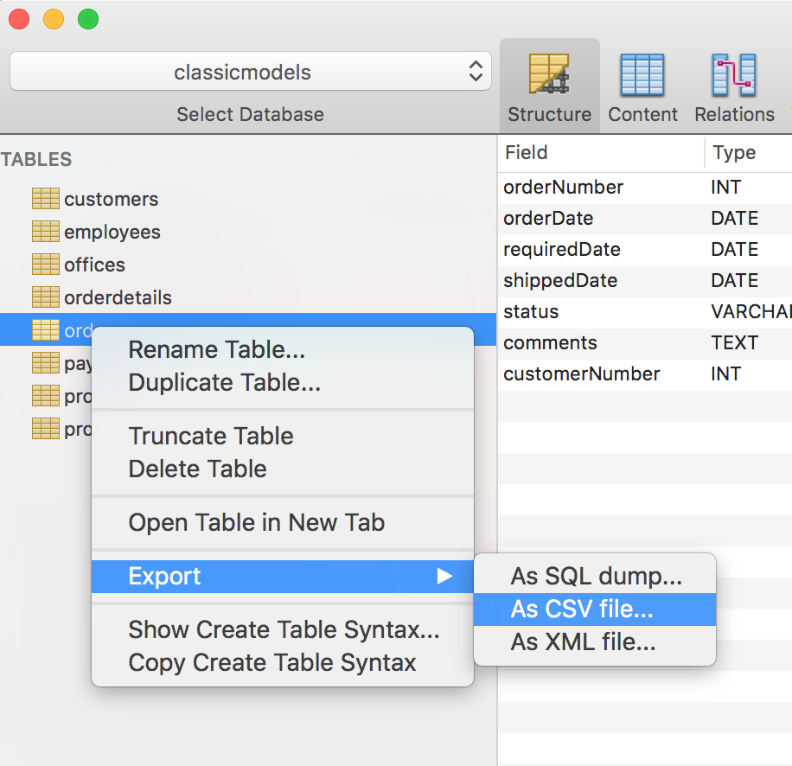
Export a table to be csv file
Right click on any table that you want to export the data, choose “Export”, and select “As CSV file”.

Slide 12
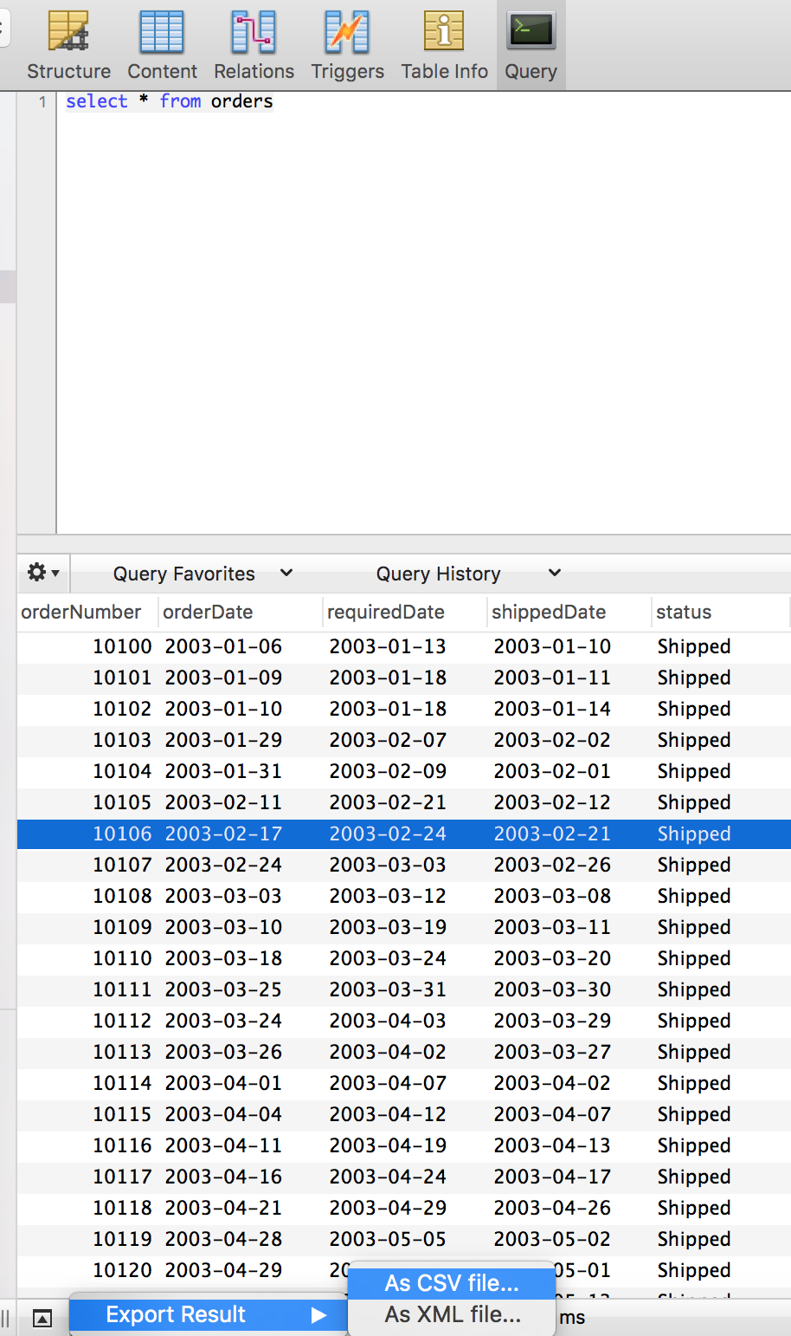

Export query result as a CSV file
After running a query, you will get some results. By clicking on the ‘gear’ icon, you will find a option to support you exporting the result as CSV file.

Slide 13
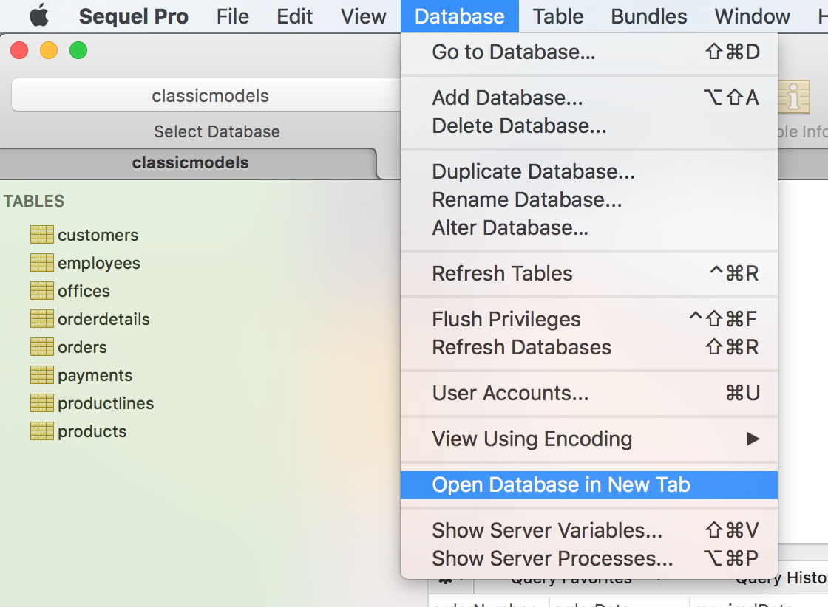
Open multiple query windows
Select “Database” from menu
Select “Open Database in New Tab”

Slide 14
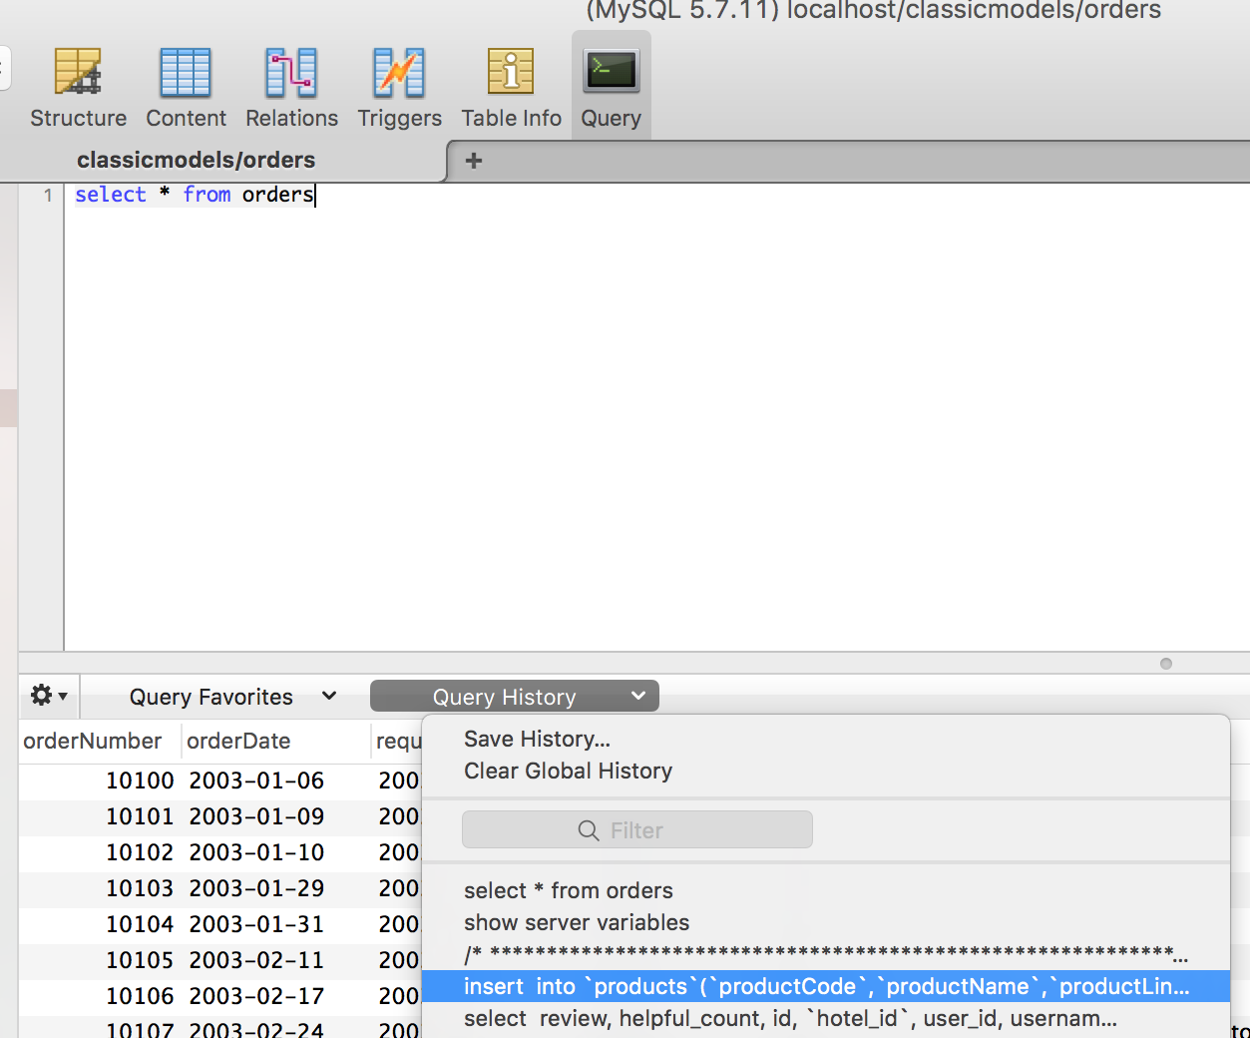
Query history In the query window, please select “Query History” from the middle of the window

Slide 15
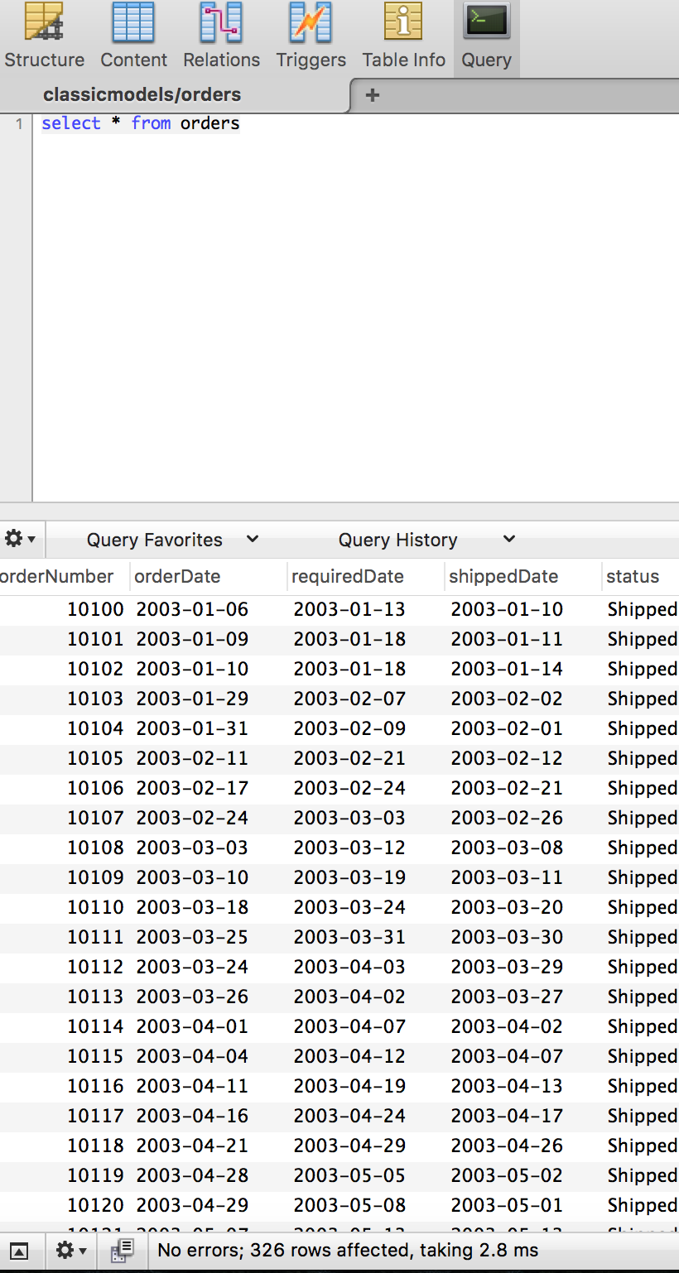
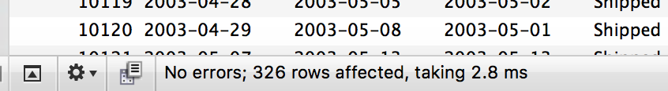
Query Result At the bottom of query window, a short summary on query outcome is available, such as the number of affected rows, and running time.

Slide 16
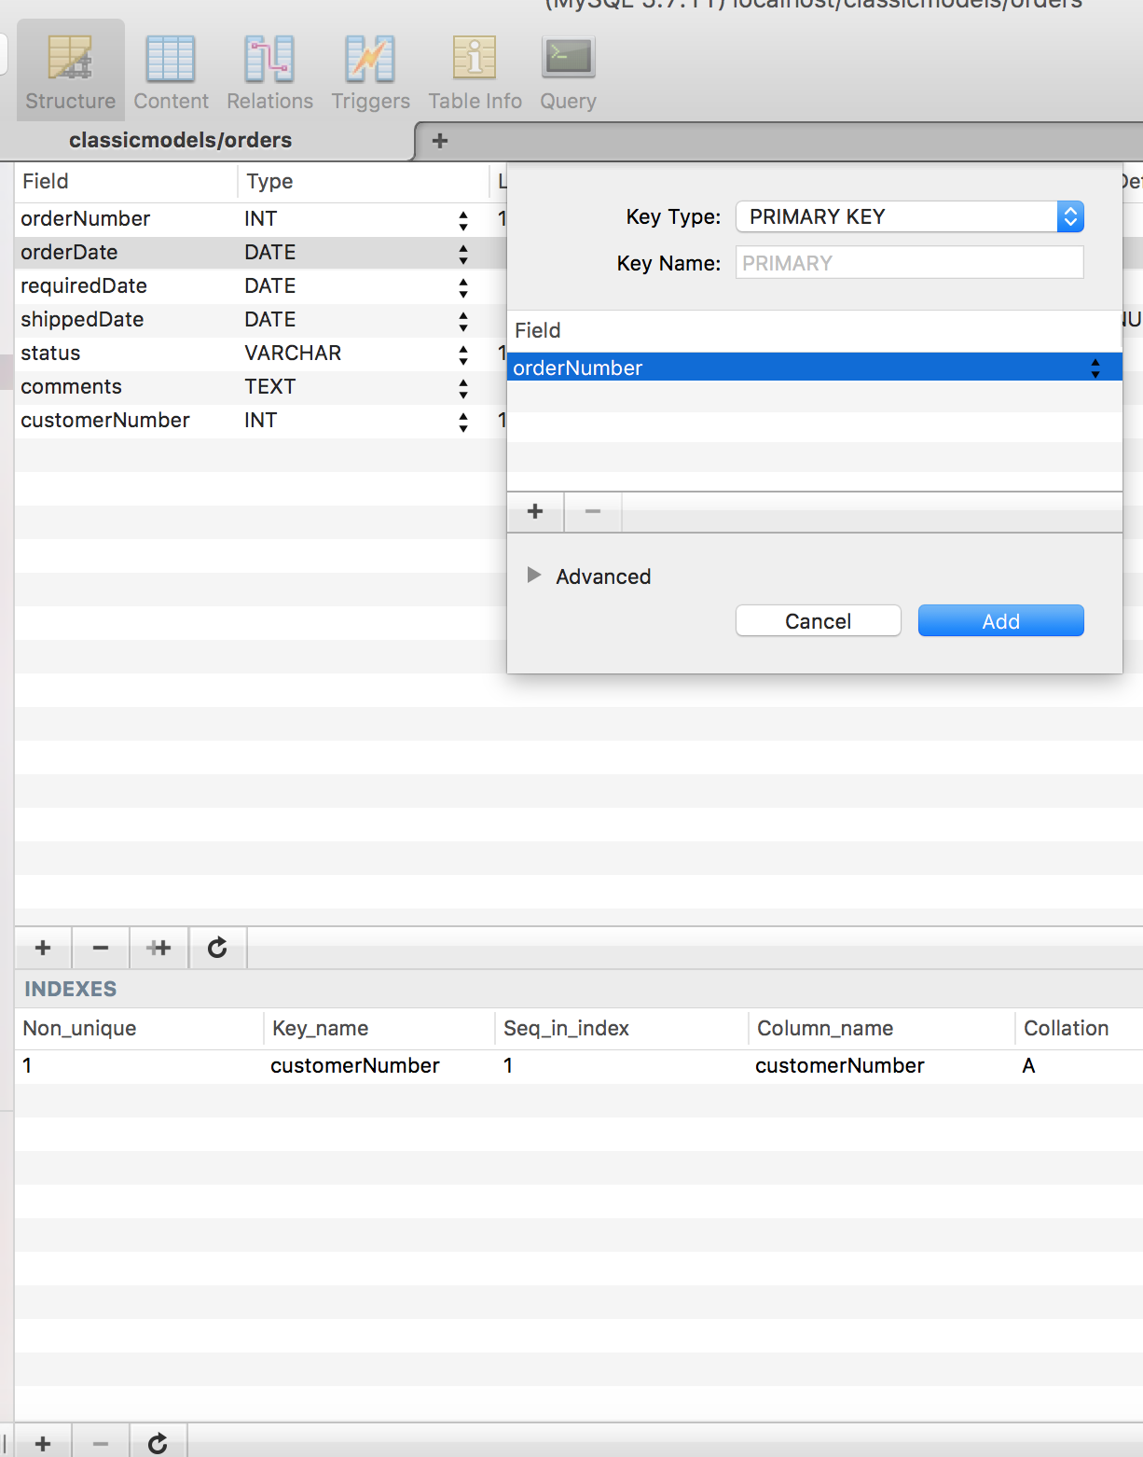
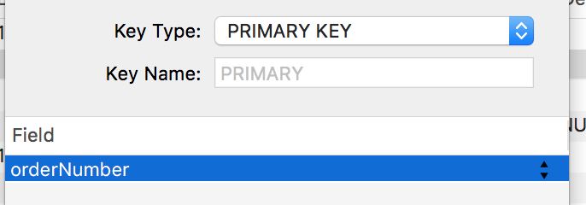
Add a key
1. In “structure” window, move to the bottom of the interface.
2. Click on “ + ”
3. Click on the triangle to select variable that you want to set up as a key
4. Choose a proper key type from “key type” option

Slide 17
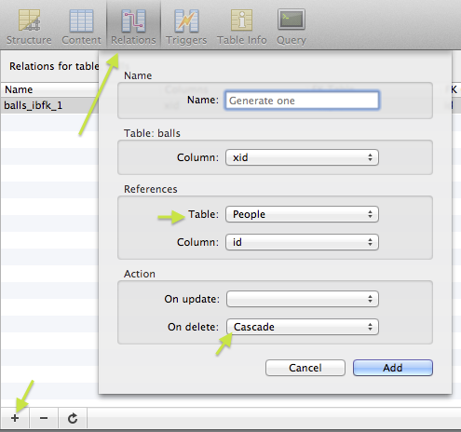
Add a foreign key
https://stackoverflow.com/questions/18583246/how-do-i-add-a-foreign-key-in-sequelpro

Slide 18
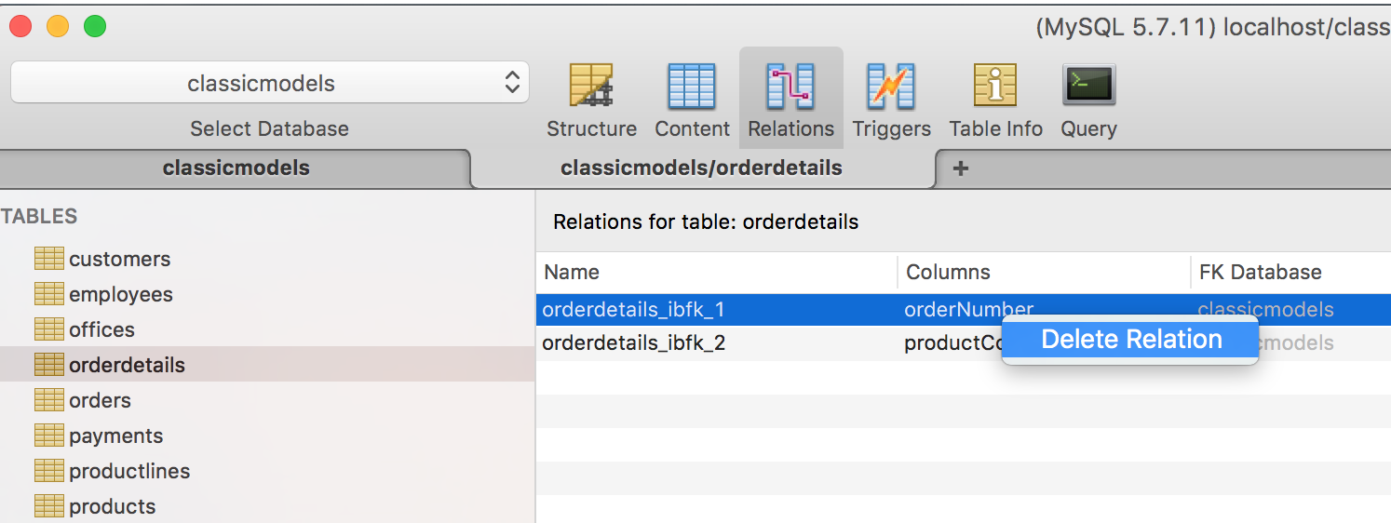
Delete foreign key
1. Go to the “Relations” window
2. Right click on a foreign key, and then click the option of “Delete Relation”.

Slide 19
Please let me know if you need more instructions concerning a specific operation.

